Slide 1
CPU Scheduling
Contents: Scheduler, Types of Scheduling, Objectives, Life Cycle, Scheduling Parameters, Scheduling Algorithms

Slide 2
Revision
What is Process,
Process elements,
Process control block,
Process creation and termination,
OS Control tables,
Threads

Slide 3
CPU Scheduler
  It selects from among the processes in memory that are ready to execute, and allocates the CPU to one of them.
  CPU scheduling decisions may take place when a process:
    Switches from running to waiting state.
    Switches from running to ready state.
    Switches from waiting to ready.
    Terminates.
  Scheduling are of Two Types.
    Preemptive Scheduling
    Non-Preemptive Scheduling

Slide 4
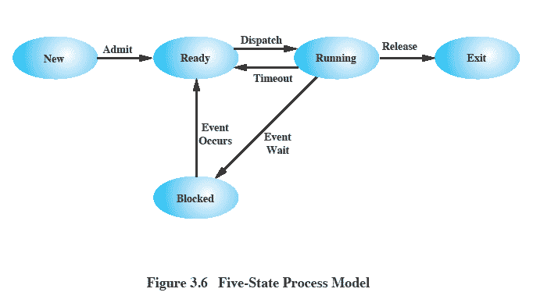
Five States Process Model

Slide 5
Non-preemptive Scheduling
  This can be used for the following reasons
    Process switches from running to waiting state.
    Process terminates.
  Ones the process gets CPU it will be released in two reasons
    If terminated
    IF switched to wait state
  It is cheaper than Preemptive, Doesn’t require extra hardware

Slide 6
Preemptive Scheduling
  This can be used for the following reasons
    Process switches from running to ready state.
    Process switches from waiting to ready
  Process releases CPU for following reasons
    If I/O operation is to be done
    If interrupt arises
  Need to modify Kernel of OS
  Needs Extra Hardware

Slide 7
Non-preemptive vs. Preemptive
  Non-preemptive
    Once a process is in the running state, it will continue until it terminates or blocks itself for I/O
  Preemptive
    Currently running process may be interrupted and moved to ready state by the OS
    Preemption may occur when new process arrives, on an interrupt, or periodically.

Slide 8
Five States Process Model

Slide 9
Scheduling
  An OS must allocate resources amongst competing processes.
  The resource provided by a processor is execution time and the resource is allocated by means of a schedule
  The aim of processor scheduling is to assign processes to be executed by the processor over time

Slide 10
Dispatcher
  Dispatcher module gives control of the CPU to the process selected by the short-term scheduler; this involves:
    switching context
    switching to user mode
  jumping to the proper location in the user program to restart that program
  Dispatch latency – time taken by the dispatcher to stop one process and start another, make it running.

Slide 11
Scheduling Objectives
The scheduling function should
  Share time fairly among processes
  Prevent starvation of a process
  Use the processor efficiently
  Have low overhead
  Prioritise processes when necessary (e.g. real time deadlines)

Slide 12
Types of Scheduling
  Long-term scheduling is performed when a new process is created - This is a decision whether to add a new process to the set of processes that are currently active.
  Medium-term scheduling is a part of the swapping function - This is a decision whether to add a process to those that are at least partially in main memory and therefore available for execution.
  Short-term scheduling is the actual decision of which ready process to execute next.

Slide 13
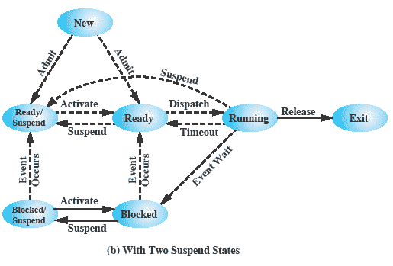
Scheduling Life Cycle

Slide 14
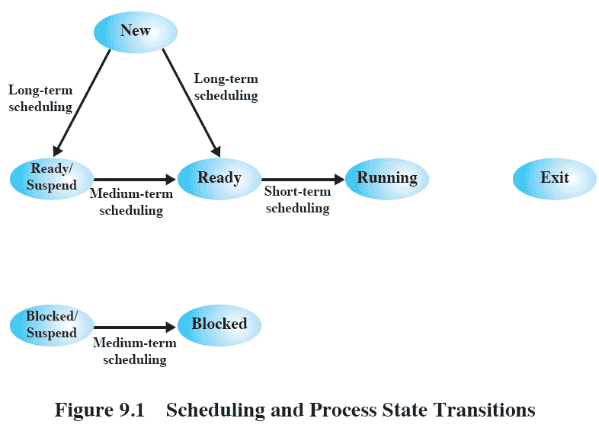
Process State Transitions

Slide 15
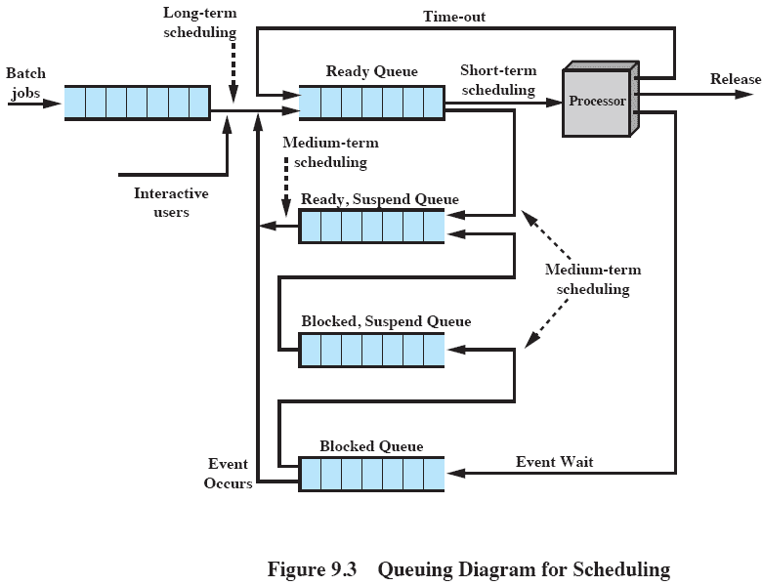
Queuing Diagram

Slide 16
Long Term Scheduling
  Determines which programs are admitted to the system for processing
    May be first-come-first-served
    Or according to criteria such as priority, I/O requirements or expected execution time
  Controls the degree of multiprogramming
  More processes, smaller percentage of time each process is executed

Slide 17
Short Term Scheduling
  Known as the dispatcher
  Executes most frequently
  Invoked when an event occurs
    Clock interrupts
    I/O interrupts
    Operating system calls
    Signals

Slide 18
Medium Term Scheduling
  Part of the swapping function
  Swapping-in decisions are based on the need to manage the degree of multiprogramming

Slide 19
Scheduling Parameters
  CPU utilization – keep the CPU as busy as possible
  Throughput – Number of processes that complete their execution per unit time
  Turnaround time – amount of time to execute a particular process. It is summation of Waiting time and execute time.
  Waiting time – amount of time a process spends waiting in the ready queue
  Response time – amount of time it takes from when a request was submitted until the first response is produced, not output.

Slide 20
Optimization Criteria
  Max CPU utilization
  Max throughput
  Min turnaround time
  Min waiting time
  Min response time

Slide 21
Scheduling Policy
  First Come First Serve
  Shortest Job First
  Round Robin
  Shortest Process First
  Shortest Remaining First
  Priority Scheduling

Slide 22
Priority
  Scheduler will always choose a process of higher priority over one of lower priority
  Have multiple ready queues to represent each level of priority

Slide 23
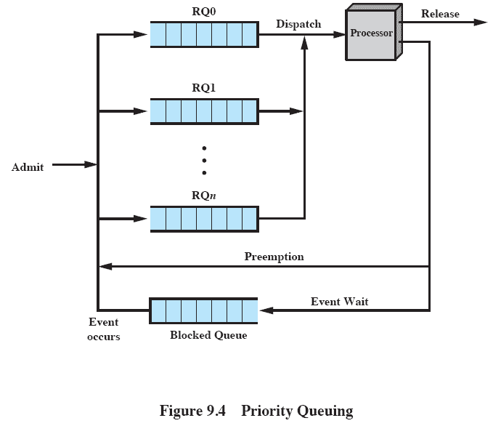
Priority Queuing

Slide 24
Starvation
  Problem:
    Lower-priority may suffer starvation if there is a steady supply of high priority processes.
  Solution
    Allow a process to change its priority based on its age or execution history

Slide 25
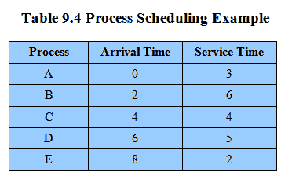
Process Scheduling
Example set of processes, consider each a batch job

Slide 26
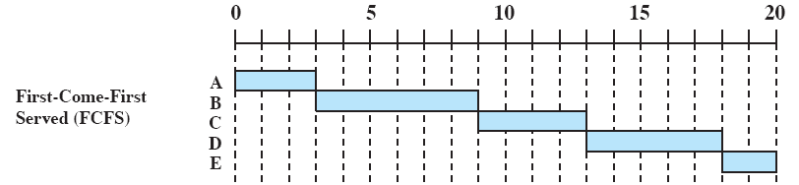
First Come First Served
  Each process joins the Ready queue, When the current process ceases to execute, the longest process in the Ready queue is selected
  A short process may have to wait a very long time before it can execute, Favors CPU-bound processes - I/O processes have to wait until CPU-bound process completes

Slide 27
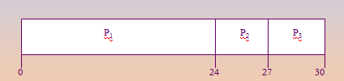
First Come First Served
  Process Burst Time
    P1 24
    P2 3
    P3 3
  Suppose that the processes arrive in the order: P1 , P2 , P3
  The Gantt Chart for the schedule is:
  Waiting time for P1 = 0; P2 = 24; P3 = 27
  Average waiting time: (0 + 24 + 27)/3 = 17

Slide 28
Shortest Job First
  Associate with each process the length of its next CPU burst. Use these lengths to schedule the process with the shortest time.
  Two schemes:
    nonpreemptive – once CPU given to the process it cannot be preempted until completes its CPU burst.
    preemptive – if a new process arrives with CPU burst length less than remaining time of current executing process, preempt. This scheme is know as the Shortest-Remaining-Time-First (SRTF).
  SJF is optimal – gives minimum average waiting time for a given set of processes.

Slide 29
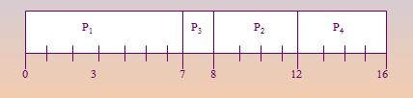
Shortest Job First
  Process Arrival Time Burst Time
  P1 0.0 7
  P2 2.0 4
  P3 4.0 1
  P4 5.0 4
  SJF (non-preemptive)
  Average waiting time = (0 + 6 + 3 + 7)/4

Slide 30

Shortest Job First
  Process Arrival Time Burst Time
  P1 0.0 7
  P2 2.0 4
  P3 4.0 1
  P4 5.0 4
  SJF (preemptive)
  Average waiting time = (9 + 1 + 0 +2)/4

Slide 31
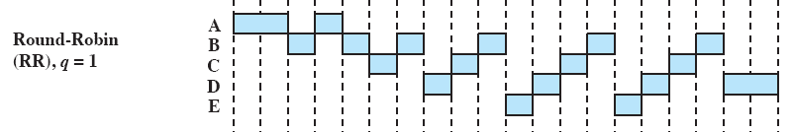
Round Robin
  Uses preemption based on a clock - also known as time slicing, because each process is given a slice of time before being preempted
  Clock interrupt is generated at periodic intervals
  When an interrupt occurs, the currently running process is placed in the ready queue - Next ready job is selected

Slide 32

Round Robin
  Process Burst Time
  P1 53
  P2 17
  P3 68
  P4 24
  Typically, higher average turnaround than SJF, but better response.

Slide 33
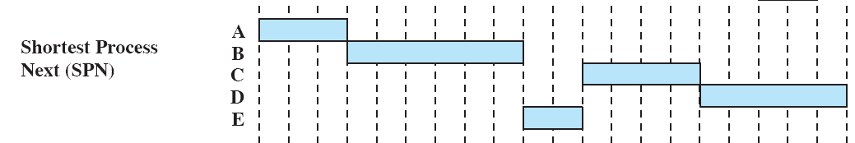
Shortest Process Next
  Non-preemptive policy
  Process with shortest expected processing time is selected next
  Short process jumps ahead of longer processes

Slide 34
Shortest Process Next
  Predictability of longer processes is reduced
  If estimated time for process not correct, the operating system may abort it
  Possibility of starvation for longer processes

Slide 35
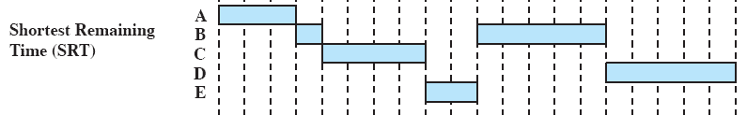
Shortest Remaining Time
  Preemptive version of shortest process next policy
  Must estimate processing time and choose the shortest

Slide 36
Priority Scheduling
  The priority number (integer) is associated with each process
    The CPU is allocated to the process with the highest priority (smallest integer ≡ highest priority).
    Preemptive vs nonpreemptive
  SJF is a priority scheduling where priority is the predicted next CPU burst time.
  Problem is Starvation – low priority processes may never execute. Solution is aging – as time progresses increase the priority of the process.

Slide 37
Revision
Types of Scheduling
Scheduling Parameters
Scheduling Algorithms
Priority Scheduling

